Slide 1

Managers As Information Processors
Information data
Some
information
put to
immediate
use
The Manager
Some information stored for
possible use later.
Some information combined
to form new information.
Some
information
discarded
Some information passed
on to others

Slide 2
Data Versus Information
Data:
  Raw figures and facts reflecting a single aspect of reality.
Information:
  Data presented in a way or form that has meaning.
Information Technology:
  The resources used by an organization to manage information that it needs to carry out its mission.
Accurate Information:
  Provides a valid and reliable reflection of reality.

Slide 3
Characteristics of Useful Information
Timely information:
  Available in time for appropriate managerial action.
Complete information:
  Provides managers with all the information they need.
Relevant information:
  Assures managers that the information is useful to them in their particular circumstances for their particular needs.

Slide 4
Information Management As Control
Information
leaving the
organization
Information
entering the
organization
Organizational System:
Information used in
the organization
Preliminary control Screening Control Post-action control

Slide 5
Building Blocks of a Computer-Based Information System
Processor
Central processing unit to organize, manipulate, sort, or calculate data
Output Medium
Printer, video, display,
other computer,
network
Input Medium
Keyboard, scanner,
other computer,
network
Storage
Disk or CD-Rom
Control System
Software or other form of operating system

Slide 6
Who Represents the Special User Category?
Knowledge workers:
  Specialists, usually professionally trained and certified (engineers, scientists, information technology specialists, psychologists), who rely on information technology to design new products or create new business processes.

Slide 7
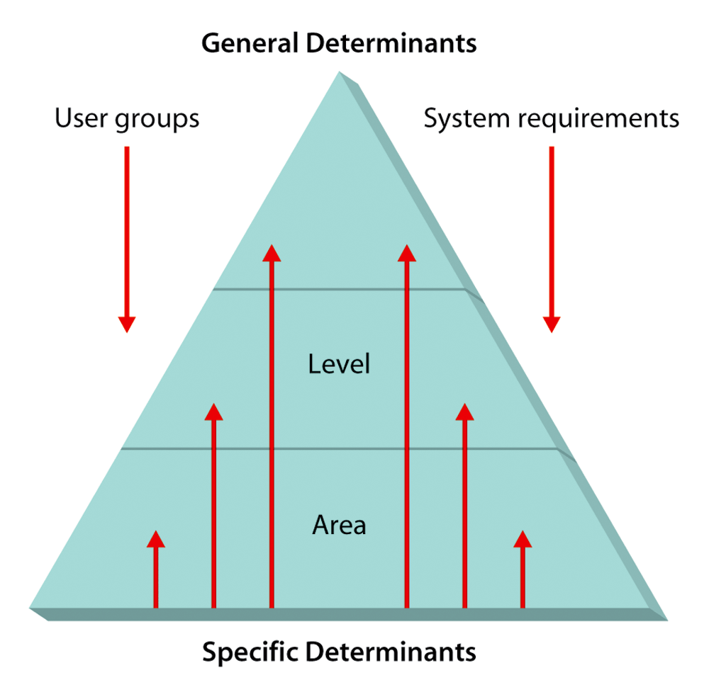
Determinants of an Organization’s Information-Processing Needs

Slide 8
Major Systems by Level
Transaction-Processing System:
  TPS, applications of information processing for basic day-to-day business transactions.
Management Information System:
  MIS, supports an organization’s managers by providing daily reports, schedules, plans, and budgets.

Slide 9
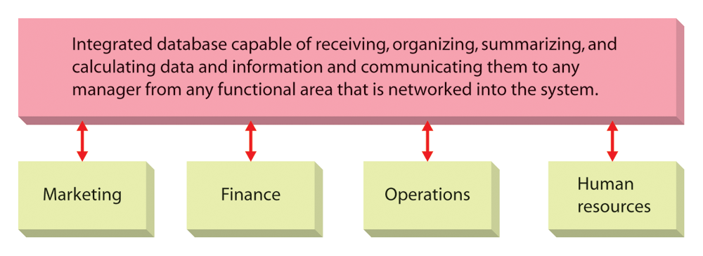
A Basic Management Information System

Slide 10
Systems by Level (cont’d):
Decision Support System:
  DSS, an interactive system that locates and presents information needed to support the decision-making process.
Executive Support System:
  ESS, a quick-reference, easy-access application of information systems specially designed for instant access by upper-level managers.

Slide 11
The Internet
What is the NET?
  A gigantic network of networks serving millions of computers and offering information on business, science, and government and providing more than 170,000 separate networks around the world.

Slide 12
Can You Define the Following?
Web browser:
  The software that enables the user to access information on the web.
Intranet:
  A communication network similar to the internet but operating within the boundaries of a single organization.
Extranet:
  Network that allows selected outsiders limited access to an organization’s information system.

Slide 13
Brief View on Creating Information Systems:
Determine
needs
Determine hardware
needs
Develop
database
Determine software
needs
Integrate databases,
hardware, and
systems
Develop documentation
Test system
Monitor system

Slide 14
The Impact of Information Systems on Organizations
Leaner organizations:
  Leading to leaner companies with fewer employees.
More flexible operations:
  Can offer customers greater variety and faster delivery cycles.
Increased collaboration:
  Among internal unites and outside firms.

Slide 15
Impact of Information Systems (cont’d):
More flexible work sites:
  Separation of the workplace from company headquarters is more common.
Improved management processes:
  Instantaneous information is accessible in a convenient, useable format.
Changed employee behavior:
  Information systems usually improve employee efficiencies.

